Slide 1
Principles of Database Systems (CS307) Lecture 4: More on Retrieving Data; Join
Ran Cheng
Department of Computer Science and Engineering
Southern University of Science and Technology
Most contents are from slides made by Stéphane Faroult, Dr. Yuxin Ma and the authors of Database System Concepts (7th Edition).
Their original slides have been modified to adapt to the schedule of CS307 at SUSTech.
Notes:
In this chapter, I will introduce how to retrieve data from one table. Just from one table. I will introduce how to retrieve data from multiple table in next chapter.

Slide 2
More on Retrieving Data Distinct

Slide 3

Distinct
No duplicated identifier
Some rules must be respected if you want to obtain valid results when you apply new operations to result sets
They must be mathematical sets, i.e., no duplicates
Notes:
In this part I will introduce an useful key word Distinct

Slide 4
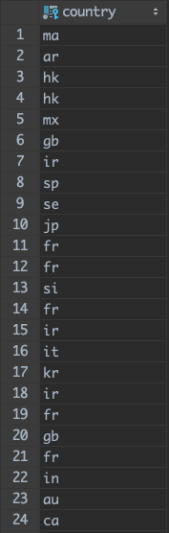
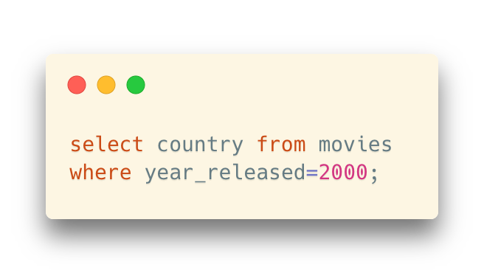
Distinct
If we run a query such as the one below
Many identical rows
In other words, we may be obtaining a table, but it's not a relation because many rows cannot be distinguished
Duplicated country codes in the query result
But their original rows are not considered duplicated tuples
Notes:
When we select some rows from a table, there may be some duplicates in them. Most of the time, we don’t want to have duplicates in the results. Such as this statement, it retures all the country codes for moives released in years 2000. Some countries had more than one moives, so the country codes would be displayed several times. You can find there are several US in the results.

Slide 5
Distinct
The result of the query is in fact completely uninteresting
Whenever we are only interested in countries in table movies, there can be only either of two reasons:
See a list of countries that have movies
Or, for instance, see which countries appear most often
Duplicated country codes in the query result
But their original rows are not considered duplicated tuples
Notes:
When we select some rows from a table, there may be some duplicates in them. Most of the time, we don’t want to have duplicates in the results. Such as this statement, it retures all the country codes for moives released in years 2000. Some countries had more than one moives, so the country codes would be displayed several times. You can find there are several US in the results.

Slide 6
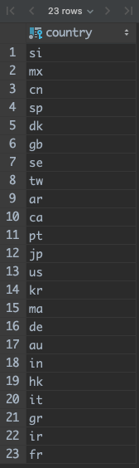
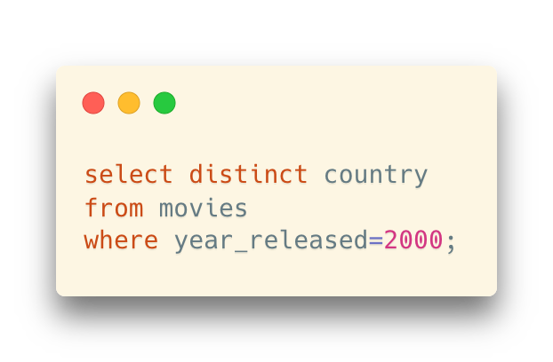
Distinct
If we are only interested in the different countries, there is the special keyword distinct.
No duplicated results in the country code list now
All of them are different now, and hence it is a relation!
Notes:
If we are only interested in the different countries, we can use the special keyword distinct.
The result is a table with one row per country, all of them different.
There are 23 countries released movies in 2000.

Slide 7
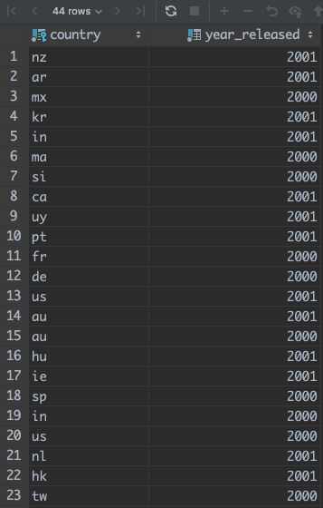
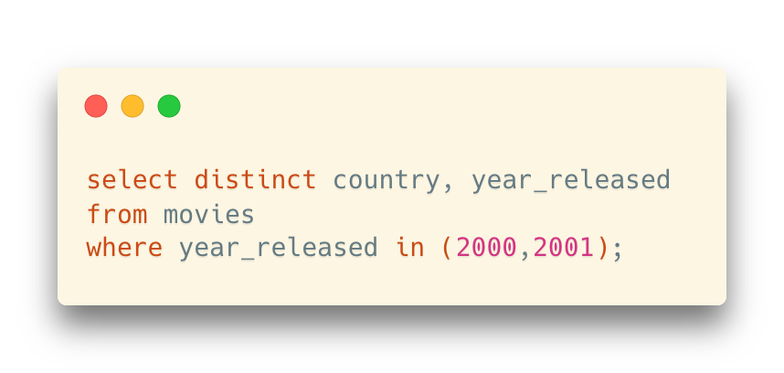
Distinct
Multiple columns after the keyword distinct
It will eliminate those rows where all the selected fields are identical
The selected combination (country, year_released) will be identical

Slide 8
More on Retrieving Data Aggregate Functions (聚合函数)

Slide 9
Aggregate Functions
Statistical functions
When we are interested in what we might call countrywide characteristics, such as how many movies released, we use Aggregate Functions.
Aggregate function will
aggregate all rows that share a feature (such as being movies from the same country)
and return a characteristic of each group of aggregated rows
Notes:
In this part, I will show you some powerful functions, they are aggregate functions!

Slide 10
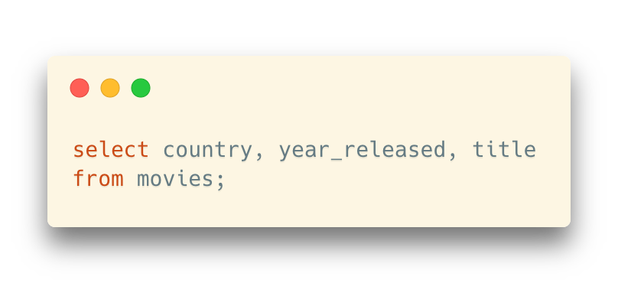
Aggregate Functions
country | year_released | title
de | 1985 | Das Boot
fr | 1997 | Le cinquième élément
fr | 1946 | La belle et la bête
fr | 1942 | Les Visiteurs du Soir
gb | 1962 | Lawrence Of Arabia
gb | 1949 | The Third Man
in | 1975 | Sholay
in | 1955 | Pather Panchali
jp | 1954 | Shichinin no Samurai
To compute an aggregated result, we'll first retrieve data
Here, all rows are in the table
Note: Just for demonstration purpose, not the real data in the table movie
Notes:
When we are interested in countrywide characteristics, such as how many movies released, we can use Aggregate functions
Aggregate function will aggregate all rows that share a feature, and return a characteristic of each group.
Take the example of movie data,
If we want to compute an aggregate result, we should first retrieve data from a table
In this example, we select country, year_released, and title from table movies.

Slide 11
Aggregate Functions
Grouped according to country
Rows with the same value will be grouped together
country | year_released | title
de | 1985 | Das Boot
fr | 1997 | Le cinquième élément
fr | 1946 | La belle et la bête
fr | 1942 | Les Visiteurs du Soir
gb | 1962 | Lawrence Of Arabia
gb | 1949 | The Third Man
in | 1975 | Sholay
in | 1955 | Pather Panchali
jp | 1954 | Shichinin no Samurai
To compute an aggregated result, we'll first retrieve data
Here, all rows are in the table
Then, data will be regrouped according to the value in one or several columns
Note: Just for demonstration purpose, not the real data in the table movie
Notes:
When we are interested in countrywide characteristics, such as how many movies released, we can use Aggregate functions
Aggregate function will aggregate all rows that share a feature, and return a characteristic of each group.
Take the example of movie data,
If we want to compute an aggregate result, we should first retrieve data from a table
In this example, we select country, year_released, and title from table movies.

Slide 12
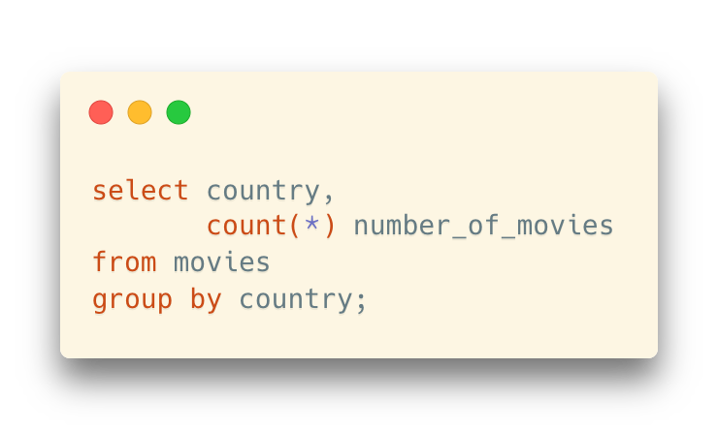
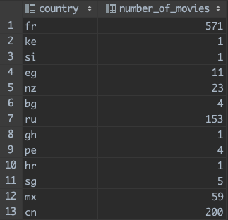
Aggregate Functions
If we want to group by country
… and, for each country (group), the aggregate function count(*) tells how many movies there are
“how many movies” = “how many rows”
The query result
One row for each group
The statistical value is attached in another column
Notes:
We want to group by country, and for each country we will use the aggregate function COUNT() to tell how many moviews in this country.
In the statement, we use GROUP BY country which means to group by country.
The results of this statement are listed here.

Slide 13
Aggregate Functions
By the way, we can rename the column of the aggregate function, like below
If we want to group by country
… and, for each country (group), the aggregate function count(*) tells how many movies there are
“how many movies” = “how many rows”
The query result
One row for each group
The statistical value is attached in another column
Notes:
We want to group by country, and for each country we will use the aggregate function COUNT() to tell how many moviews in this country.
In the statement, we use GROUP BY country which means to group by country.
The results of this statement are listed here.

Slide 14
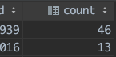
Aggregate Functions
By the way, we can rename the column of the aggregate function, like below
… or, the client will generate a temporary name
If we want to group by country
… and, for each country (group), the aggregate function count(*) tells how many movies there are
“how many movies” = “how many rows”
The query result
One row for each group
The statistical value is attached in another column
Notes:
We want to group by country, and for each country we will use the aggregate function COUNT() to tell how many moviews in this country.
In the statement, we use GROUP BY country which means to group by country.
The results of this statement are listed here.

Slide 15
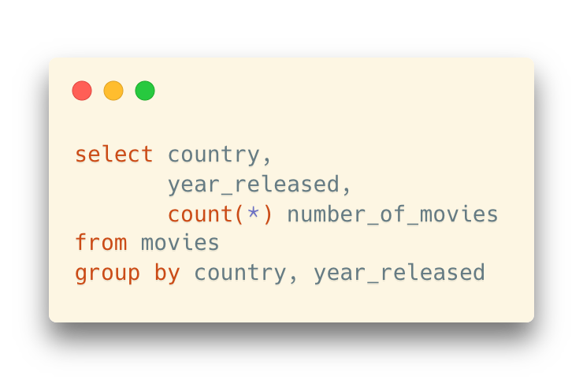
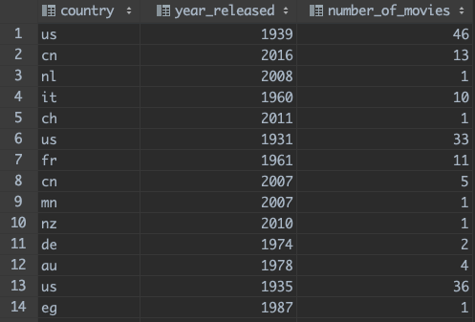
Aggregate Functions
Group on several columns
Any column that is NOT returned by an aggregate function and appears after select must also appear after group by
The combination of the countries and released years will appear in the result
Notes:
We can also group on several columns. The column names will follow GROUP BY. We can list them here
Every column that isn't an aggregate function and appears after SELECT must also appear after GROUP BY.
If no, the SQL engine will report an error. You can try it, and think why.
This is the result of this statement.

Slide 16
Aggregate Functions
Beware of some performance implication
When you apply a simple where filter, you can start returning rows as soon as you have found a match.
where
---- | --- | ---
---- | --- | ---
Notes:
We can apply a WHERE filter, only rows match the filter will be returned. It can improve performence of the statement.

Slide 17
Aggregate Functions
Beware of some performance implication
With a group by, you must regroup rows before you can aggregate them and return results.
In other words, you have a preparatory phase that may take time, even if you return few rows in the end.
In interactive applications, end-users may not always understand it well.
group by
(regrouping)
--- | --- | ---
--- | --- | ---
--- | f(x)
Notes:
Compared with the statements without GROUP BY, one more step is needed.
That means in the first step, the SQL engine selects the rows we needed,
In the second step, we use the aggregate fucntion to return some values. If you use the keyword distinct, the SQL engine will compare all rows selected and remove duplicates.

Slide 18
Aggregate Functions
count(*)/count(col), min(col), max(col), stddev(col), avg(col)
These aggregate functions exist in almost all products
Most products also implement other functions
Some work with any datatype, others only work with numerical columns
It is strongly recommended to refer to the database manual for details
For example, SQLite does not have stddev() for computing the standard deviation
Notes:
There are some other aggregate functions. They can be found in almost all products.
Count function can return the number of rows;
MIN returns the minimal value of a colunmn, and MAX is for the maximal value. AVE is for the average value, and STDDEV() is for the standard deviation.

Slide 19
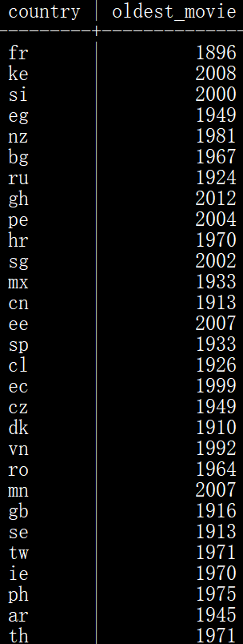
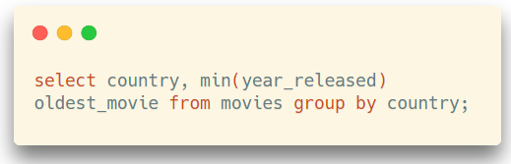
Aggregate Functions
Earliest release year by country?
Such a query answers the question
Note that in the demo database years are simple numerical values, but generally speaking min() applied to a date logically returns the earliest one.
The result will be a relation: no duplicate, and the key that identifies each row will be the country code (generally speaking, what follows GROUP BY).
Notes:
If we want to show the earliest release year by country. We can use function min as show in this statement.
This statement demonstrates how to use function MIN().
No duplicates in the returned results. And the country code can be the key.

Slide 20
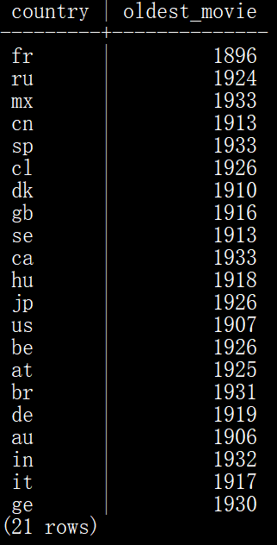
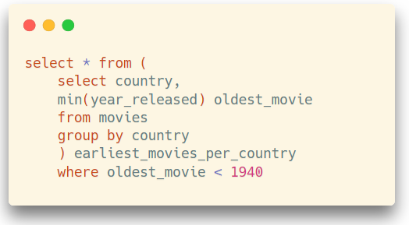
Aggregate Functions
Therefore we can validly apply another relational operation such as the "select" operation (row filtering) and only return countries for which the earliest movie was released before 1940.
Nesting Query (嵌套查询)
Notes:
So we can apply another SELECT operation.
It will only return countries for which the earliest movie was released before 1940.

Slide 21
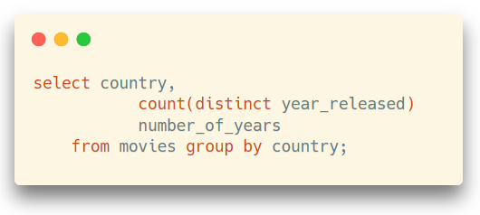
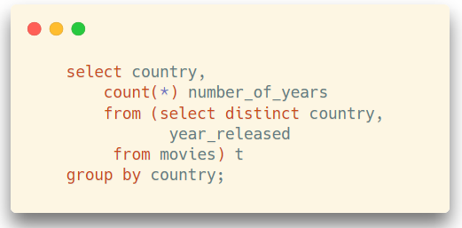
Aggregate Functions
These two queries are equivalent
Notes:
Now we have a relatively difficult question.
How many people are both actors and directors.
First we know the data needed is in table credits.

Slide 22
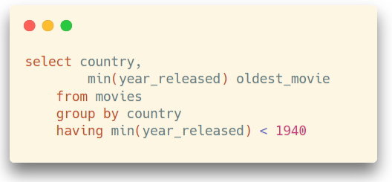
Aggregate Functions
There is a short-hand that makes nesting query unnecessary (in the same way as AND allows multiple filters). You can have a condition on the result of an aggregate with having.
Now, keep in mind that aggregating rows requires sorting them in a way or another, while sorting is always costly operations that do NOT scale well (Why?).
Notes:
We can also use aggregate functions with the keyword HAVING
In this example having is followed by min(year_released), we can put more conditions here.
But we cannot use aggregate functions in WHERE.
Please kind in mind that aggregating rows may require sorting them.

Slide 23
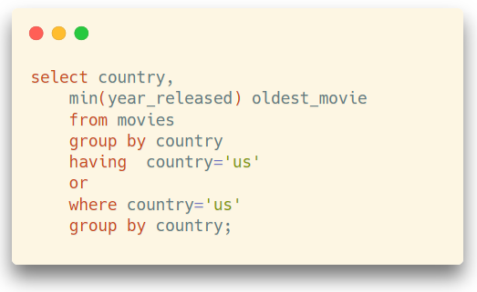
Aggregate Functions
SORT：Time complexity of sorting algorithms: O(n*log(n))
The following query is perfectly valid in SQL. What you are doing is aggregating movies for all countries, then discarding everything that is not American:
The efficient way to proceed is of course to select American movies first, and only aggregate them.
SQL Server will do the right thing behind your back. – Query Optimization
Oracle will assume that you have some obscure reason for writing your query
that way and will do as told. It can hurt.
Or…
Notes:
Sorting is always cost a lot of time when the scale of the data is large.
Time complexity of a sorting algorithm is this
When N is large, the complexity will increase a lot.
The query is valid in SQL, it can also return the results you expected. It will return the year in which the first American movie was released.
In this SQL statement, it aggregate movies from all countries, then discard all rows those are not American. Since the aggregating is carried out on the data from all countries, it isn’t an efficient statement.
The efficient way is to select American movies first, and then aggregate them.
If you run the two statement in MS SQL server, SQL server will finish the tasks in the same manner. That means SQL server is smart.
But Oracle will not. Oracle will run the statements as it means. Oracle think you must have some reason to do so.
The difference is that SQL server think it’s smarter than you, it can help you to optimize.

Slide 24
Aggregate Functions
All database management systems have a highly important component that we'll see again, called the "query optimizer".
It takes your query, and tries to find the most efficient way to run it.
Sometimes it tries to outsmart you, with from time to time unintended consequences
Sometimes it optimistically assumes that you know what you are doing
... In all, optimizers may not behave all the same. – So, please reply on yourself, not the optimizer.
Notes:
All DMBSs have a component, query optimizer.
The optimizer takes your query, and tries to find the most efficient way to run it.
Sometimes the optimizer think it’s smarter than you, and help you do optimization; but sometimes it may think you have some reasons to write the SQL statemants in that way. Different optimizers don’t behave the same.

Slide 25
Aggregate Functions
How about NULL?
When you apply a function or operators to a null, with very few exceptions the result is null because the result of a transformation applied to something unknown is an unknown quantity. What happens with aggregates?
known + unknown = unknown
Notes:
We should talk about NULL
We know that if we apply an operation or function to a null, most of the time, the result will be null.
What will happen with aggregate functions?

Slide 26
Aggregate Functions
How about NULL?
Aggregate functions ignore NULLs
Notes:
When tables contain huge number of rows, you are usually interested with only a small subset. And only want to return some of the rows.
Aggregate functions will ignore nulls

Slide 27
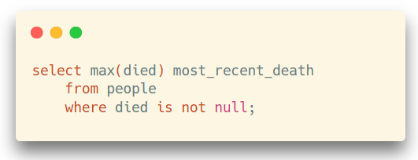
Aggregate Functions
In this query, the WHERE condition changes nothing to the result (perhaps it makes more obvious that we are dealing with dead people only, but for the SQL engine it's implicit)
Notes:
Such as in this statement, the WHERE condition is DIED IS NOT NULL.
Actrually the condition cannot change the result. Only the data which is not null will be computed by aggregate functions.

Slide 28
Aggregate Functions
count(*)
count(col)
Depending on the column you count, the function can therefore return different values. count(*) will always return the number of rows in the result set, because there is always at least one value that is NOT null in a row (otherwise you would not have a row in the first place)
Notes:
Count(*) will always return the number of rows in the result.
But count(col) may not because there may be some NULL in this column.

Slide 29
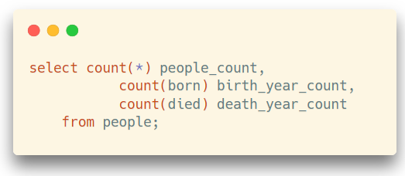
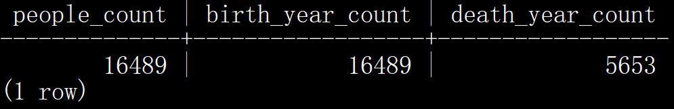
Aggregate Functions
Counting a mandatory column such as BORN will return the same value as COUNT(*)
The third count, though, will only return the number of dead people in the table.
Notes:
So we can use count function to return the non-null values in a column.
In the examples, we can return the number of people by COUNT(*),
The number of people with birth years, the number is the same with the total number of people.
The last one, the number of death years are 5653, that means in the table 5600 persons have passed away.

Slide 30
Aggregate Functions
select count(colname)
select count(distinct colname)
In some cases, you only want to count distinct values. For instance, you may want to count how many different surnames starting with a Q instead of how many people have a surname starting with a Q.
Notes:
In some cases, you only want to count distinct values. You can put keyword distinct HERE
For instance, you may want to count how many different surnames start with a Q instead of how many people have a surname that starts with a Q.
You can put keyword distinct HERE

Slide 31
Aggregate Functions
How many people are both actors and directors?
credits
Notes:
When tables contain huge number of rows, you are usually interested with only a small subset. And only want to return some of the rows.

Slide 32
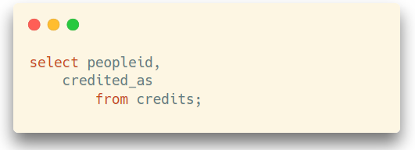
Aggregate Functions
There is no restriction such as "that have played in a movie that they have directed", so the movieid is irrelevant. But if we remove the movieid, we have tons of duplicates. Not a relation!
movie_id | people_id | credited_as
8 | 37 | D
8 | 38 | A
8 | 39 | A
8 | 40 | A
10 | 11 | A
10 | 12 | A
10 | 15 | D
10 | 16 | A
10 | 17 | A
Notes:
Since the movie id has no relationship with the problem, we can just select people ID and credited_as, these two columns.
But there are many duplicates in the results…

Slide 33
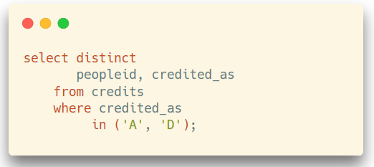
Aggregate Functions
People who appear twice are the ones we want.
DISTINCT will remove duplicates and provide a true relation. I specify the values for CREDITED_AS because there is no other value now, but you cannot predict the future (someday there may be producers or directors of photography, i.e., some role other than ‘A’ or ‘D’).
people_id | credited_as
11 | D
11 | A
12 | A
15 | A
16 | A
17 | A
37 | D
38 | A
39 | A
Notes:
We can use DISTINCT to remove duplicates and get a true relation.
WHERE here can make sure that only A and D are selected.

Slide 34
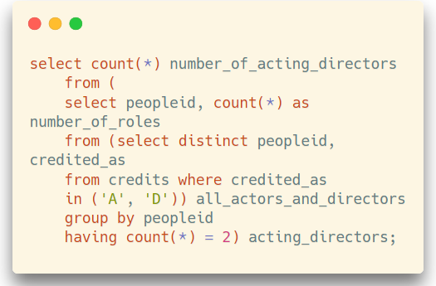
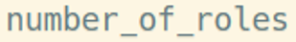
Aggregate Functions
The HAVING selects only people who appear twice ... and we just have to count them. Mission accomplished.
Notes:
We have listed all actors and directors using this statement. We put the results into a virtual table ALL_Actors_and_directors
Then we can use an aggregating function COUNT() to count the number of a peopleID. IF a peropleID appears two times, we will keep the result.
Now we have another virtual table. The table has two colunms, peopleid and the number of roles. The values in the second column are all 2.
The last step is easy, just count the number of rows. Then we can get how many people are both as actors and directors.

Slide 35
Join

Slide 36
Retrieving Data from Multiple Tables
We have seen the basic operation consisting in filtering rows (an operator called SELECT by Codd)
Notes:
Now let’s move to the most exciting part and challenging part. Retrieving data from multiple tables.
In the past weeks we have learnt how to filter some rows from a table using SELECT

Slide 37
Retrieving Data from Multiple Tables
We have seen how we can only return some columns (called PROJECT by Codd), and that we must be careful not to return duplicates when we aren't returning a full key.
Notes:
We also knew how to return some columns, it is called PROJECT by Codd.
We should be careful not to return duplicates when we are not returning a full key.

Slide 38
Retrieving Data from Multiple Tables
We have also seen how we can return data that does not exist as such in tables by applying functions to columns.
Notes:
We can also return data that doesn’t exist in table, and we can apply functions to columns.

Slide 39

Retrieving Data from Multiple Tables
What is REALLY important is that in all cases our result set looks like a clean table, with no duplicates, and a column (or combination of columns) could be used as a key
If this is the case, we are safe. This must be true at every stage in a complex query built by successive layers.
Notes:
It is really important that the result sets should look like a clean table, without duplicates and a column or combination of columns can be used as a key.

Slide 40

Retrieving Data from Multiple Tables
It is time now to see how we can relate data from multiple tables.
This operation is known as JOIN.
We have already seen a way to relate tables:
foreign key constraints.
Notes:
Now I will introduce how to query data from multiple tables.
The operation to combine several tables is know as JOIN.
In the past we have already had a way to connect different tables, foreign key constraints

Slide 41
Retrieving Data from Multiple Tables
The COUNTRY column in MOVIES can be
used to retrieve the country name from
COUNTRIES.
movieid | title | country | year_released
1 | Casab | us | 1942
2 | Goodfellas | us | 1990
3 | Bronenosets Potyomkin | ru | 1925
4 | Blade Runner | us | 1982
5 | Annie Hall | us | 1977
country_code | country_name | continent
ru | Russia | Europe
us | United States | America
in | India | Asia
gb | United Kingdom | Europe
Notes:
The COUNTRY column in MOVIES can be used to retrieve the country name from COUNTRIES.
If you want to know the detailed country information of MovieID=6, you can find the detailed information in table countries by the code CN.

Slide 42
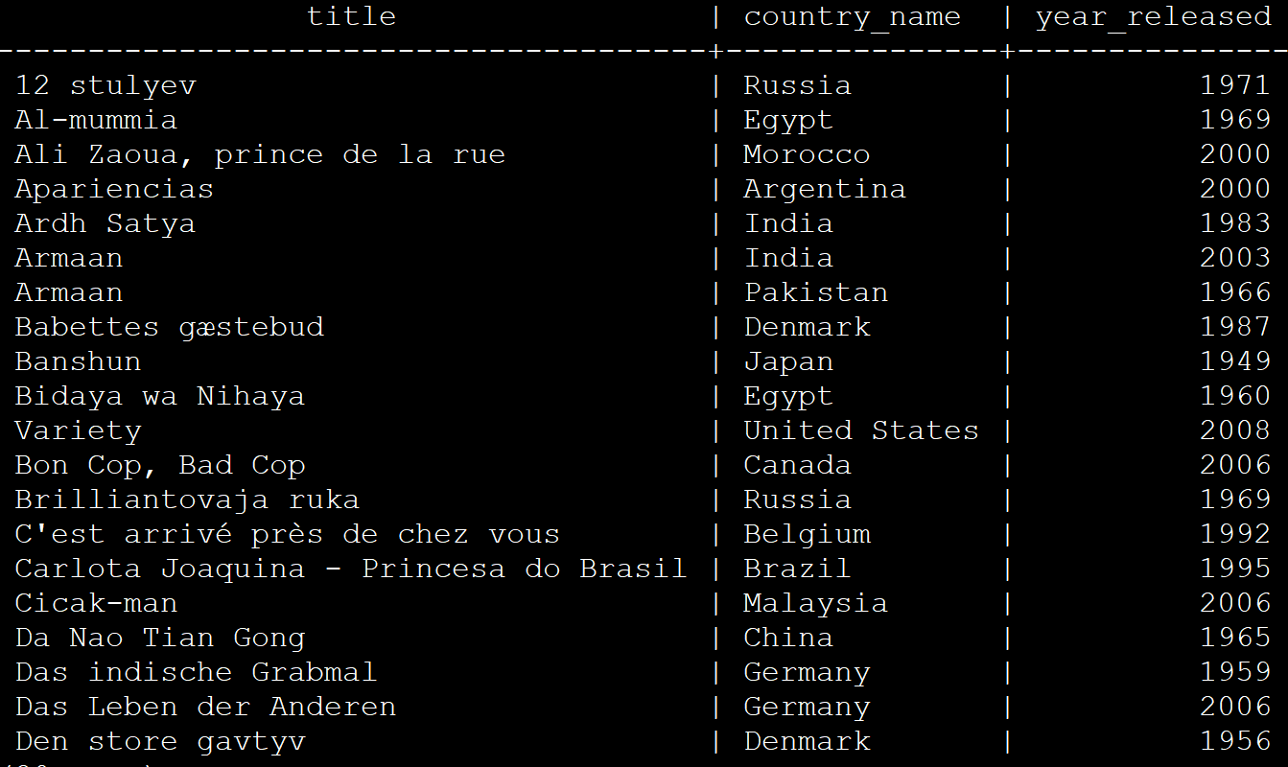
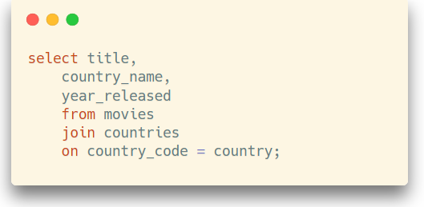
Retrieving Data from Multiple Tables
This is done with this type of query. We retrieve, and display as a single set, pieces of data coming from two different tables.
Notes:
we want to show movie titles, the full country names and the year released. Because the full country names are in another table, so we should join the two tables.

Slide 43
Retrieving Data from Multiple Tables
movies join countries
The join operation will create a virtual table with all combinations between rows in Table1 and rows in Table2.
If Table1 has R1 rows, and Table2 has R2, the huge virtual table has R1xR2 rows.
movieid | title | country | year_released | country_code | country_name | continent
1 | Casablanca | us | 1942 | ru | Russia | Europe
1 | Casablanca | us | 1942 | us | United States | America
1 | Casablanca | us | 1942 | in | India | Asia
1 | Casablanca | us | 1942 | gb | United Kingdom | Europe
1 | Casablanca | us | 1942 | ru | Russia | Europe
Notes:
Let me explain what’s join, …

Slide 44
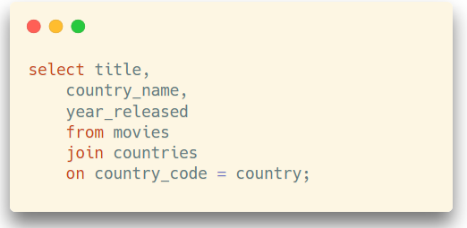
Retrieving Data from Multiple Tables
The join condition tells which values (columns) in each table must match for filtering the results
Notes:
The join condition says which values in each table must match
With this join condition…

Slide 45
Retrieving Data from Multiple Tables
We use on country_code = country to filter out unrelated rows to make a much smaller virtual table.
movies join countries
movieid | title | country | year_released | country_code | country_name | continent
1 | Casablanca | us | 1942 | ru | Russia | Europe
1 | Casablanca | us | 1942 | us | United States | America
1 | Casablanca | us | 1942 | in | India | Asia
1 | Casablanca | us | 1942 | gb | United Kingdom | Europe
1 | Casablanca | us | 1942 | ru | Russia | Europe
Notes:
only the rows which meet the condition will be kept, all unrelated rows will be removed.
Now the virtual table is much smaller.

Slide 46
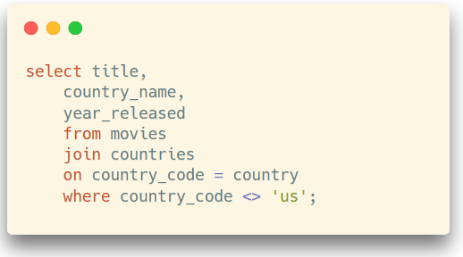
Retrieving Data from Multiple Tables
From this virtual table
Retrieve some columns and apply filtering conditions to any column
movieid | title | country | year_released | country_code | country_name | continent
1 | Casablanca | us | 1942 | us | United States | America
2 | Goodfellas | us | 1990 | us | United States | America
3 | Bronenosets Potyomkin | ru | 1925 | ru | Russia | Europe
4 | Blade Runner | us | 1982 | us | United States | America
Notes:
From this virtual table, we can continue retrieve some columns, and apply filtering conditions to any column.
This is the new filtering added.
Since there are no duplicates, the result set is a relation.
We can also change the order of the table.

Slide 47
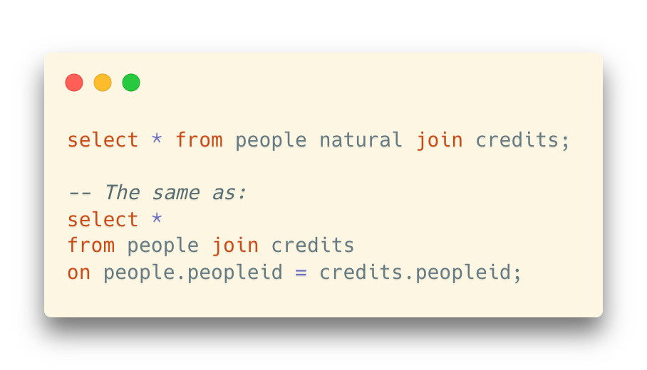
Natural Join
What if we do not specify the column?
Natural join (same name & same type & only one column in each table)

Slide 48
Natural Join
What if we do not specify the column?
Natural join (same name & same type & only one column in each table)
Use using to specify the column with the same name (NOT necessarily same type)
“If a column has the same name, then we should join on it”
Bad idea!
Same name != Same semantic

Slide 49
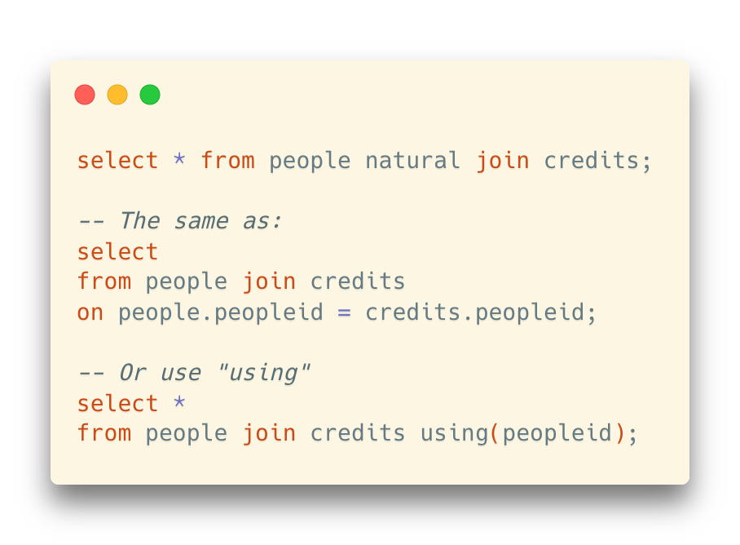
Natural Join
What if we do not specify the column?
Natural join (same name & same type)
Use using to specify the column with the same name (NOT necessarily same type)
“If a column has the same name, then we should join on it”
Bad idea!
Same name != Same semantic

Slide 50
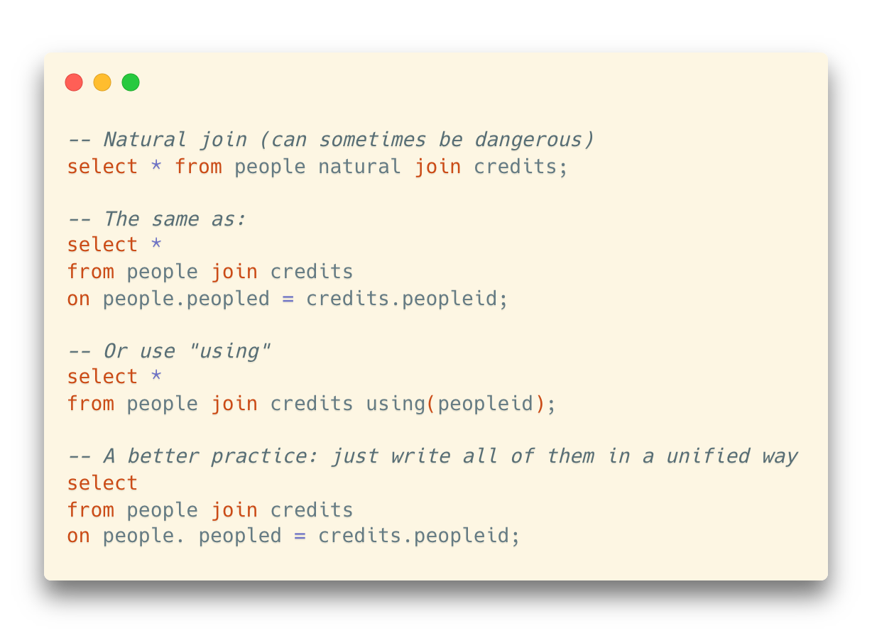

(Maybe) A Good Practice in Writing Queries
It is preferred not to depend on how database designers name their columns
It can be a good practice to use a single (and sometimes straightforward) syntax that works all the time
Keep it simply stupid

Slide 51
Self Join
Join the same table together
For example: How can we find all the pairs of people with the same first name?

Slide 52
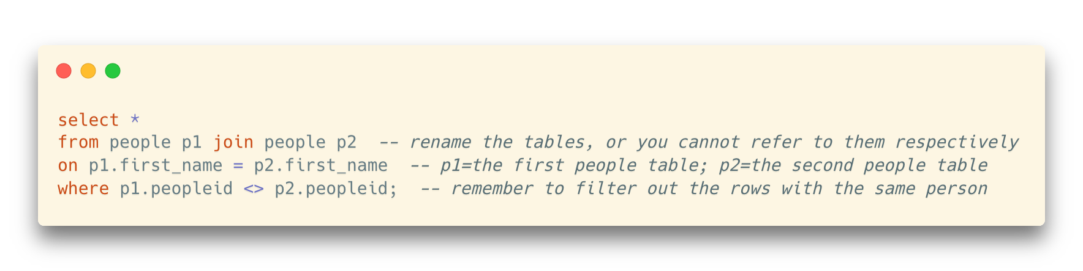
Self Join
Join the same table together
For example: How can we find all the pairs of people with the same first name?

Slide 53
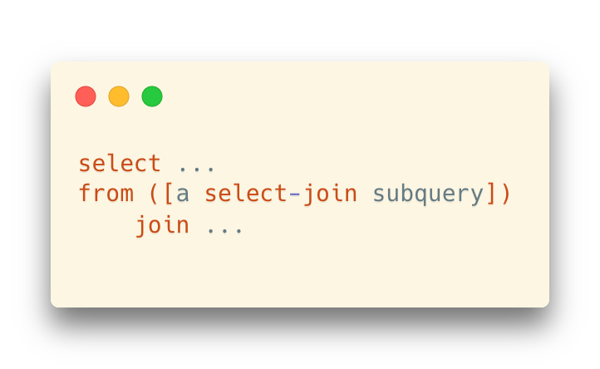
Join in a Subquery
A join can as well be applied to a subquery seen as a virtual table
… as long as the result of this subquery is a valid relation in Codd's sense

Slide 54
Chaining Joins Together
We can also chain joins the same way we chain filtering conditions with AND.
Joins between 10 or 15 tables are not uncommon, and queries generated by programs often do much worse.

Slide 55
Chaining Joins Together
We can also chain joins the same way we chain filtering conditions with AND.
Joins between 10 or 15 tables are not uncommon, and queries generated by programs often do much worse.
Example: Show names of actors and directors for Chinese movies

Slide 56
Chaining Joins Together
We can also chain joins the same way we chain filtering conditions with AND.
Joins between 10 or 15 tables are not uncommon, and queries generated by programs often do much worse.
Example: Show names of actors and directors for Chinese movies

Slide 57
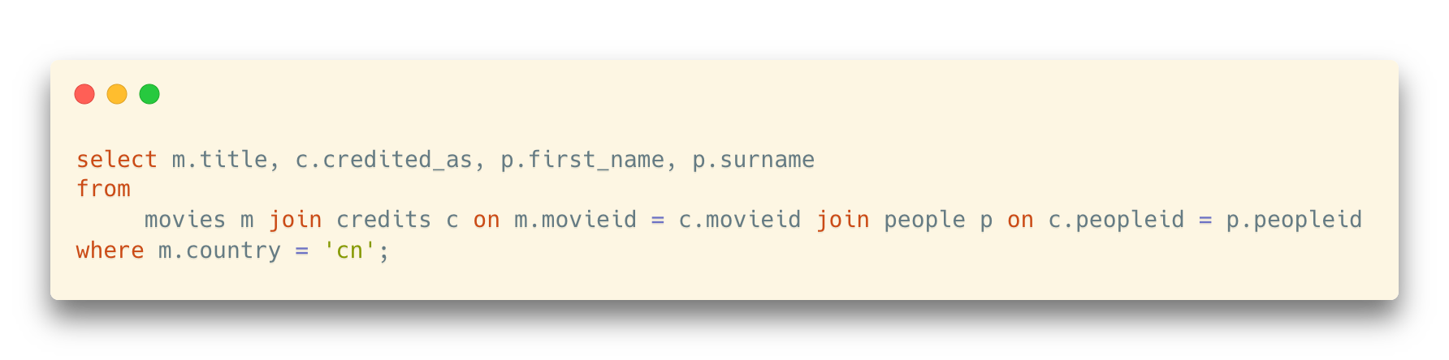
Chaining Joins Together
We can also chain joins the same way we chain filtering conditions with AND.
Joins between 10 or 15 tables are not uncommon, and queries generated by programs often do much worse.
Example: Show names of actors and directors for Chinese movies

Slide 58
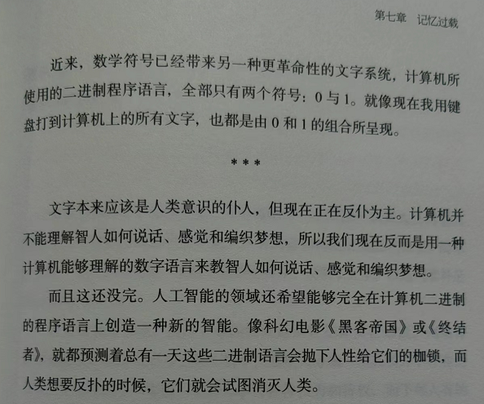
《人类简史》

